Slide 1

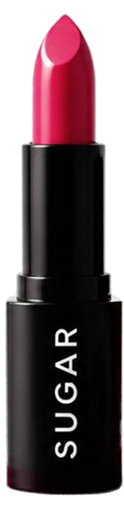
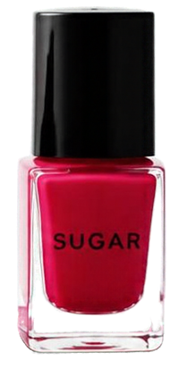
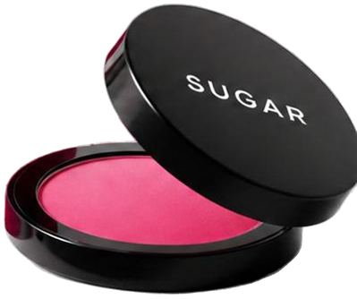
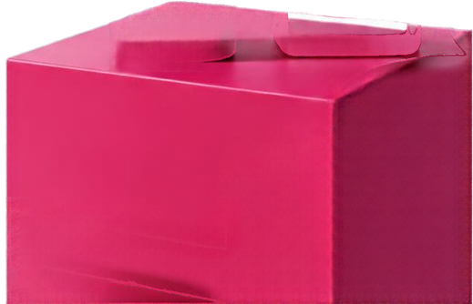


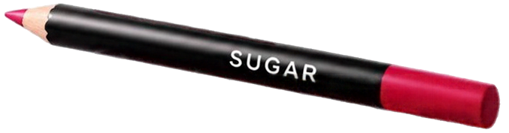
SUGAR COSMETICS
INSTAGRAM
PERFORMANCE
INSIGHTS AND STRATEGY
APRIL 2024 - APRIL 2025
Sugar Cosmetics | Instagram Insights

Slide 2
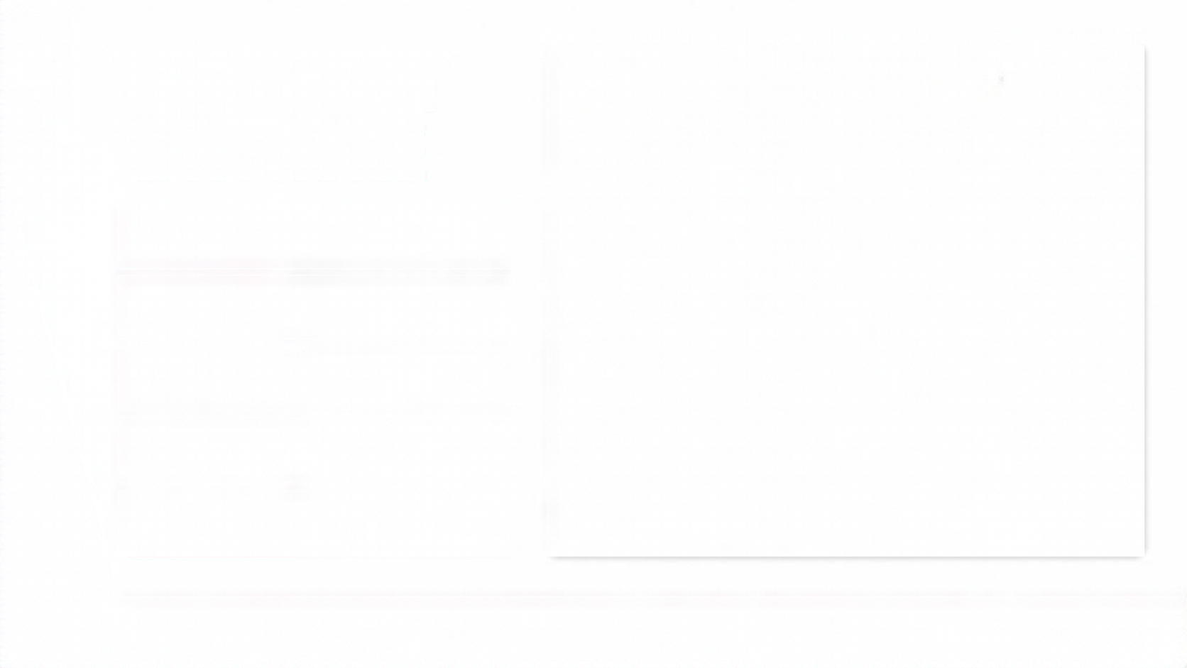



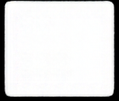
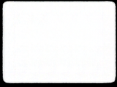
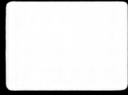
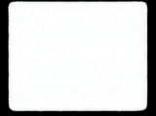
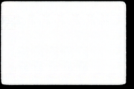

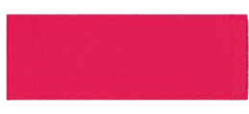
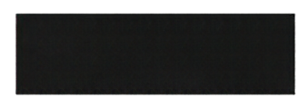
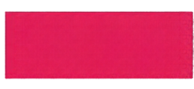
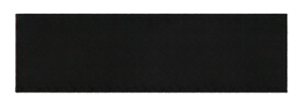
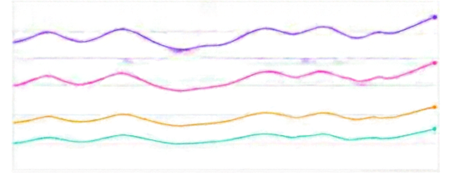
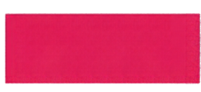
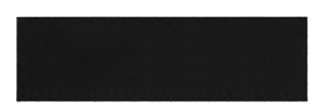
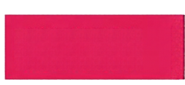
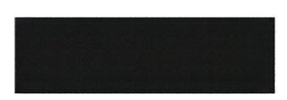


THE ACCOUNT
Overview KPIs
Apr 2024 - Apr 2025
AT A GLANCE
Posts
Reach
Likes
Comments
Avg. Engagement Rate
50K
987.42M
147.73M
18.46M
18.55%
50K
posts
Performance Over Time
Reach
Likes
987.42M
987.42M
147.73M
reach
1- vs previous period
1- vs previous period
Comments
18.46M
T vs previous period
147.73M
likes
Avg. Engagement Rate
18.55%
18.46M
comments
Audience Snapshot
Content Snapshot
Total Followers
Follower Growth
Top Country
Top Content
Tyre
Top Performing Post
18.55%
average engagement rate
XX.XM
XX.XM
XX.X%
XX.X%
XX.X%
Sugar Cosmetics | Instagram Insights

Slide 3
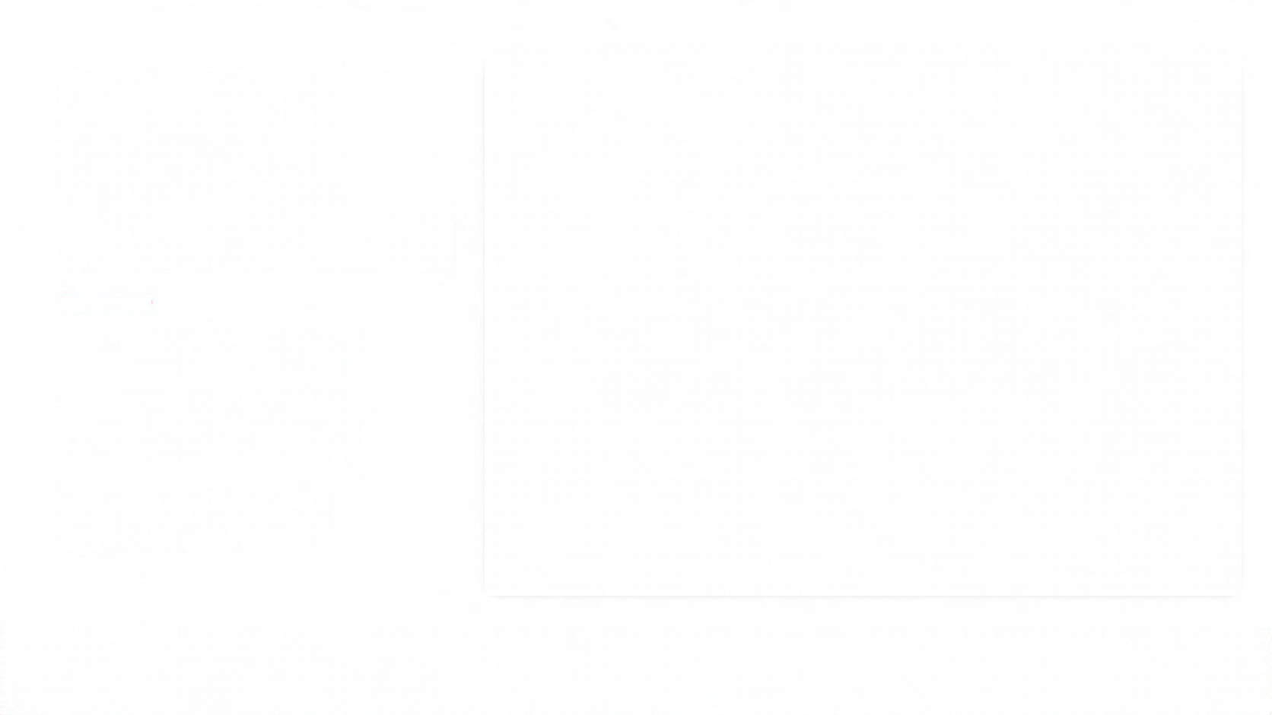
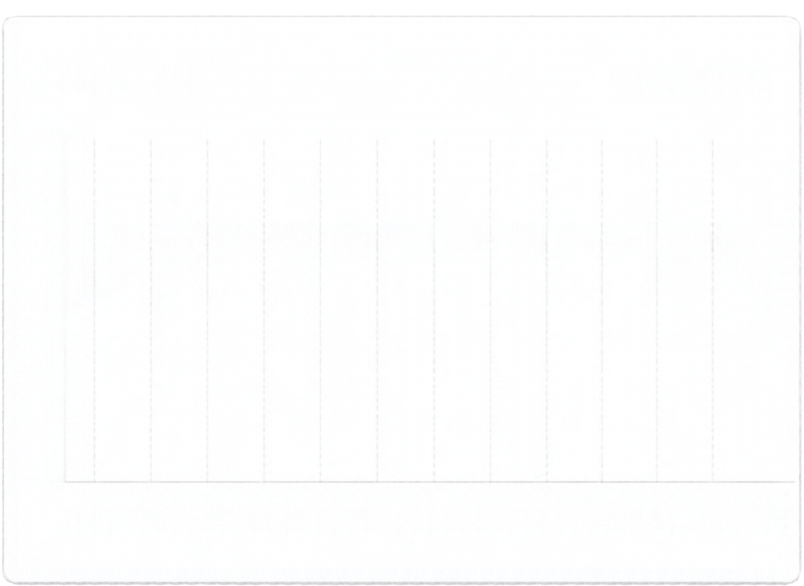

POSTING IS CONSISTENT MONTH TO MONTH
Posts Over Time
Apr 2024 – Apr 2025
6K
5K
4K
3K
2K
1K
0
About 4,100 posts per month
April 2024 and April 2025 are partial months, not real drops
Implication: maintain the
current cadence
Apr May Jun Jul Aug Sep Oct Nov Dec Jan Feb Mar Apr
2024 2024 2024 2024 2024 2024 2024 2025 2025 2025 2025
Sugar Cosmetics | Instagram Insights

Slide 4
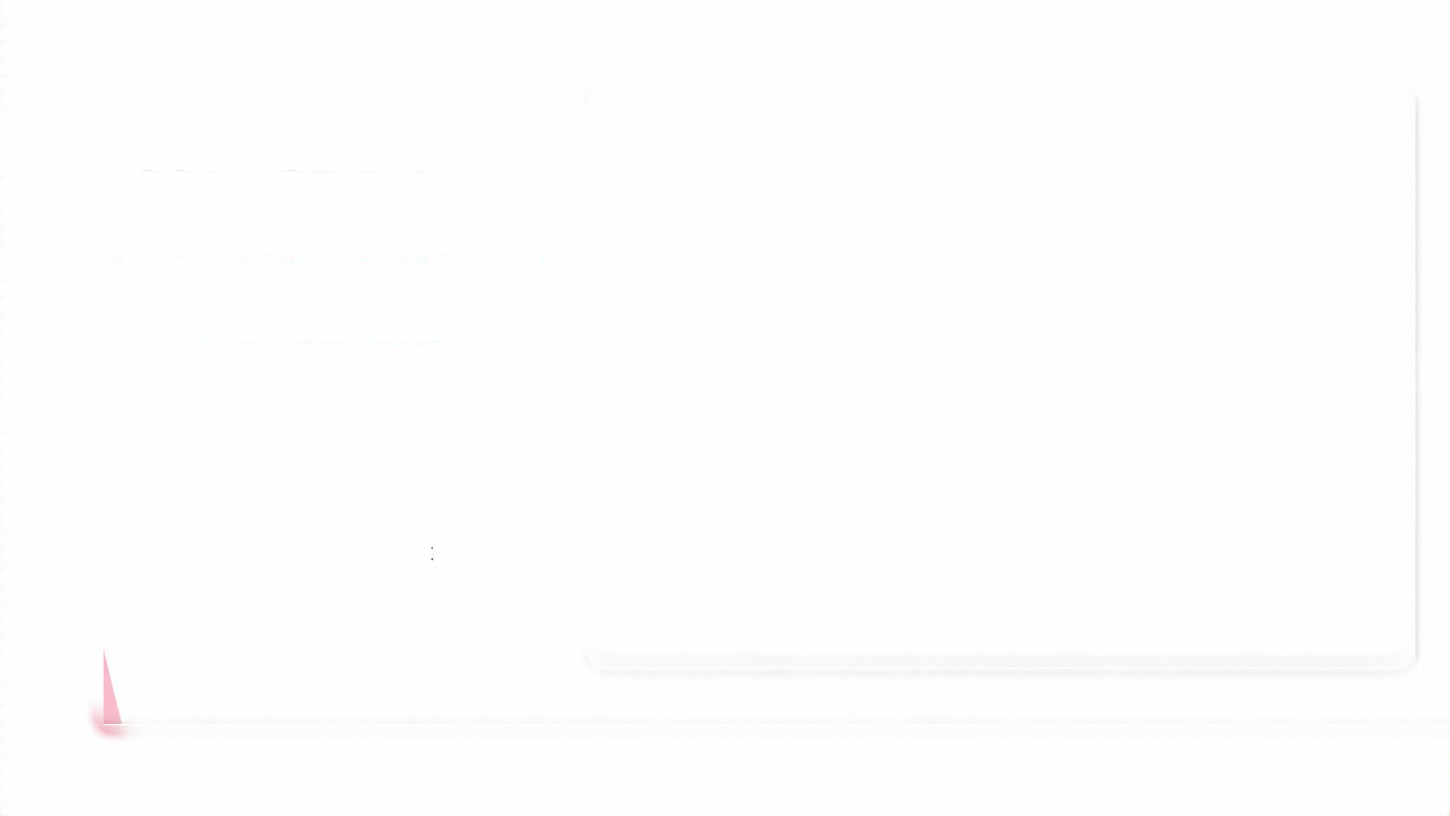

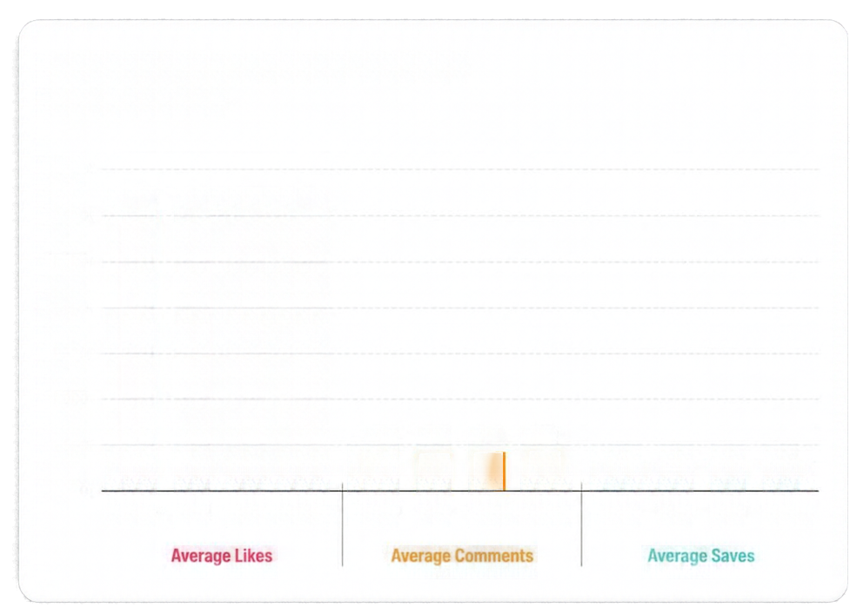












POST FORMAT
Average Engagement by Post Format
Apr 2024 – Apr 2025
DOES NOT DECIDE
3,500
3,000
2,500
2,000
1,500
1,000
500
0
2,967
2,941
2,958
2,956
PERFORMANCE
Image, Reel, Story, and Video are within about 1% on average likes (~2,950), comments (~369), and saves (~177)
371
362
368
372
178
175
176
179
Implication: don’t shift budget
between formats
Image
Reel
Story
Video
Image
Reel
Story
Video
Image
Reel
Story
Video
Average Likes
Average Comments
Average Saves
Sugar Cosmetics | Instagram Insights

Slide 5




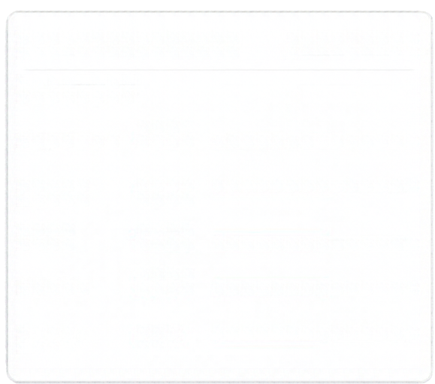







TIMING AND HASHTAGS
ARE WEAK LEVERS
Engagement by Weekday
Apr 2024 - Apr 2025
Hashtag Performance Comparison
Apr 2024 - Apr 2025
Weekday engagement ranges narrowly from 18.47% (Sunday) to 18.61% (Friday)
Avg. Engagement Rate
Avg. Engagement Rate
Monday
18.52%
#sugarcosmetics
18.58%
Five core hashtags perform within about half a point
of each other
Tuesday
18.54%
#sugarfamily
18.52%
Wednesday
18.50%
Thursday
18.58%
#trysugar
18.27%
Friday
18.61%
Treat Friday and Saturday
as test slots, not proven
winners
#sugarlook
18.19%
Saturday
18.54%
Sunday
18.47%
#sugarbae
18.11%
Sugar Cosmetics | Instagram Insights

Slide 6

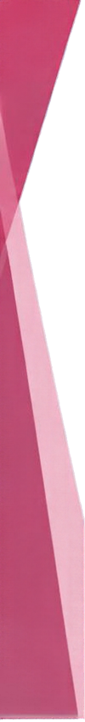


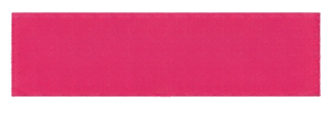




WHERE THE
Impressions
100%
AUDIENCE DROPS OFF
Reach
77%
IReach is about 77% of impressions
Likes
15%
Likes are about 15% of reach
Comments, shares, and saves each under 2% of reach
Comments
<2%
Shares
<2%
Design content that earns saves and shares
Saves
<2%
Sugar Cosmetics | Instagram Insights

Slide 7


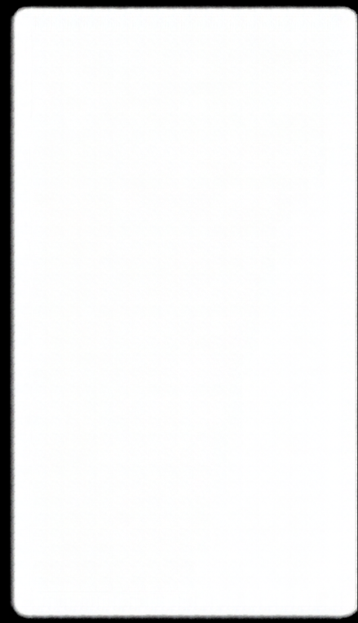
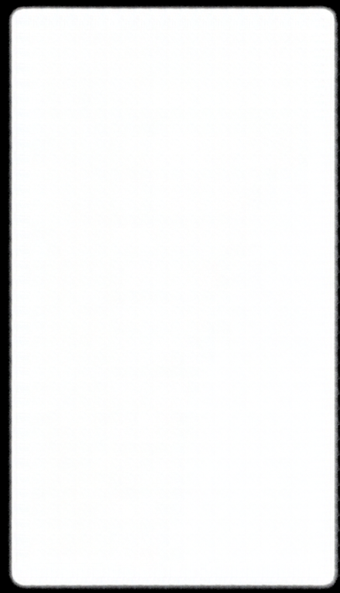
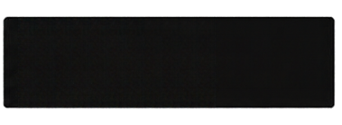
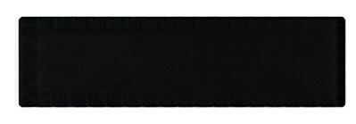
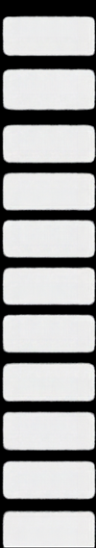
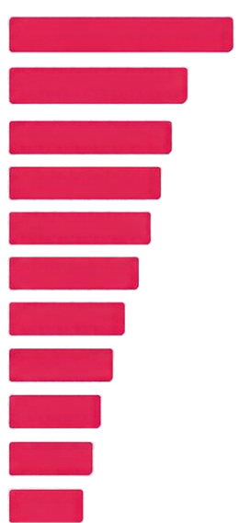
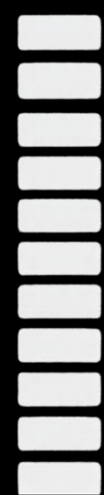
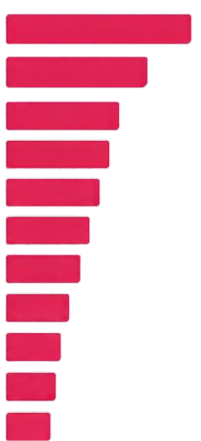

HIDDEN GEMS
TOP 10 BY
ENGAGEMENT RATE
TOP 10 BY
LIKES
2X
TOP POSTS BEAT THE AVERAGE BY NEARLY
Top 10 posts by engagement rate reach about 34% vs. 18.55% average
They are not the most-liked posts
They span every post type
Implication: study what these posts share and replicate it
Sugar Cosmetics | Instagram Insights

Slide 8


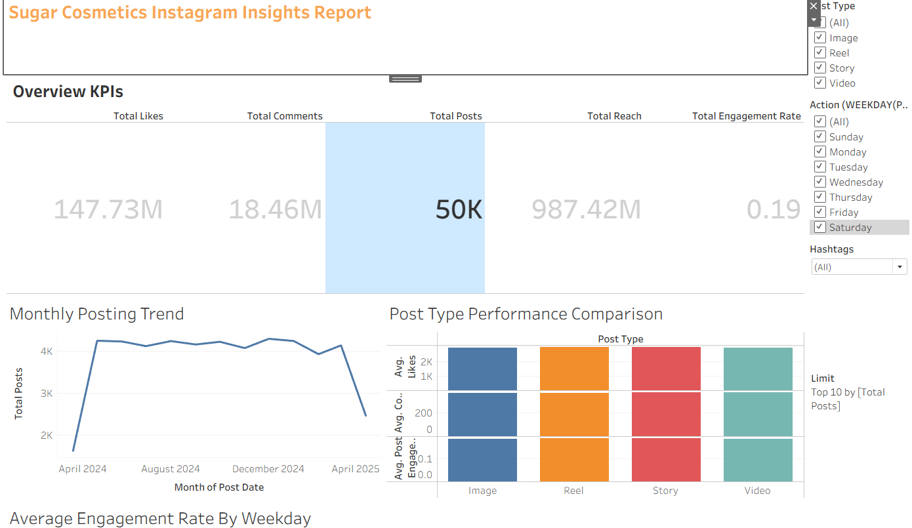





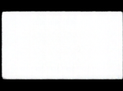
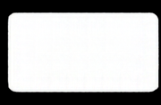
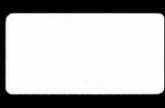
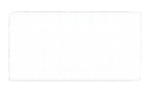
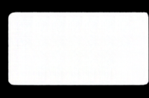
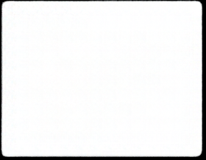
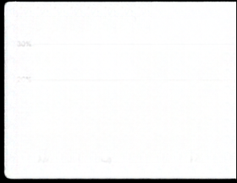
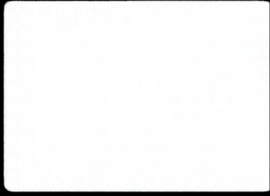
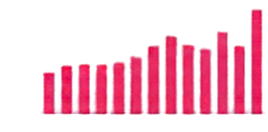
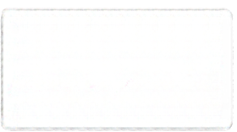
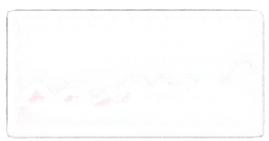




INTERACTIVE
Dashboard
Apr 2024 - Apr 2025
Click any bar to filter every chart.
DASHBOARD
Posts
Reach
Likes
Comments
Avg. Engagement Rate
50K
987.42M
147.73M
18.46M
18.55%
FOR THE MARKETING TEAM
Reach by Post Type
Engagement Rate by Month
Top Hashtags by Reach
Filter by post type, month and hashtag; click any bar to filter every chart.
Reach Over Time
Likes Over Time
Comments Over Time
Sugar Cosmetics | Instagram Insights

Slide 9


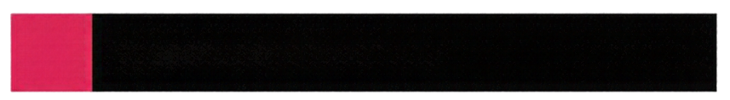




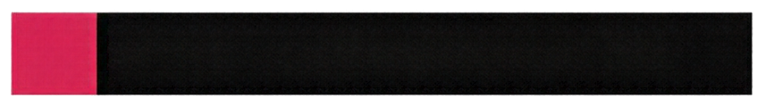

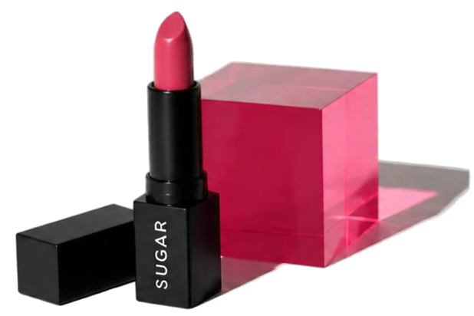






RECOMMENDATIONS
Keep the daily posting cadence
AND NEXT STEPS
Don’t shift budget between formats
Create save-worthy tutorials and shareable content
Replicate the traits of top engagement posts
Test Friday and Saturday as hypotheses
Fill data gaps (captions, timestamps, follower counts, campaign and audience-emotion analysis)
Growth will come from content quality and targeted tests, not scheduling tweaks.
Sugar Cosmetics | Instagram Insights

